Slide 1
DIGITAL MARKETING INTERNSHIP
Comprehensive Digital Marketing For
HDFC BANK
A PROJECT ON HDFC BANK UNDER THIS ESTEEMED GUIDANCE OF
K.RATNA KUMARI MADAM
PRESENTED BY
PASUPULETI JYOTHSNA
Reg No:213888200065
Sri Vasavi Degree college Tadepalligudem

Slide 2
HDFC BANK
SMART BRIDGE ORGANISATION
GROUP MEMBERS
1. Team Leader : Pasupuleti Jyothsna
2.Team Member : Chalamcharla Padmavathi
3.Team Member : Patsa Jyothirmai Durga Bhavani
4.Team Member : Peetala Vidya Prasanthi
5.Team Member : Katakam Lakshmi Sravya

Slide 3
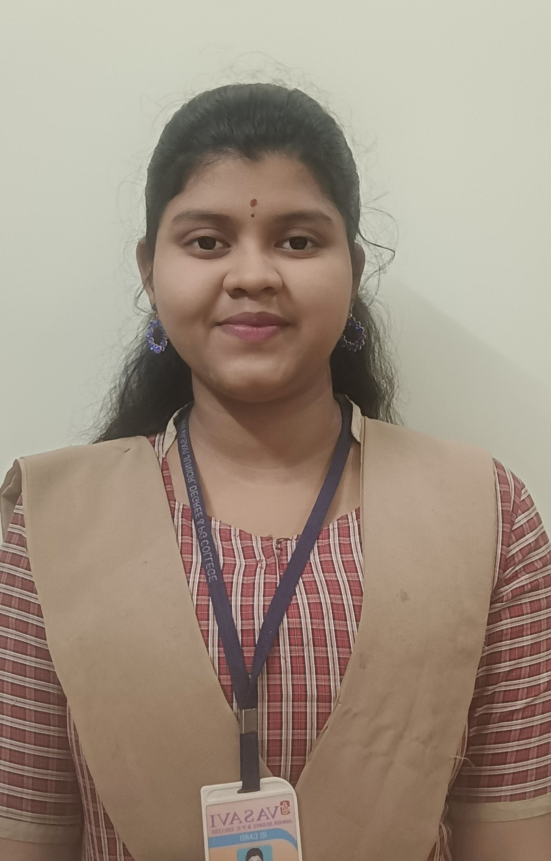
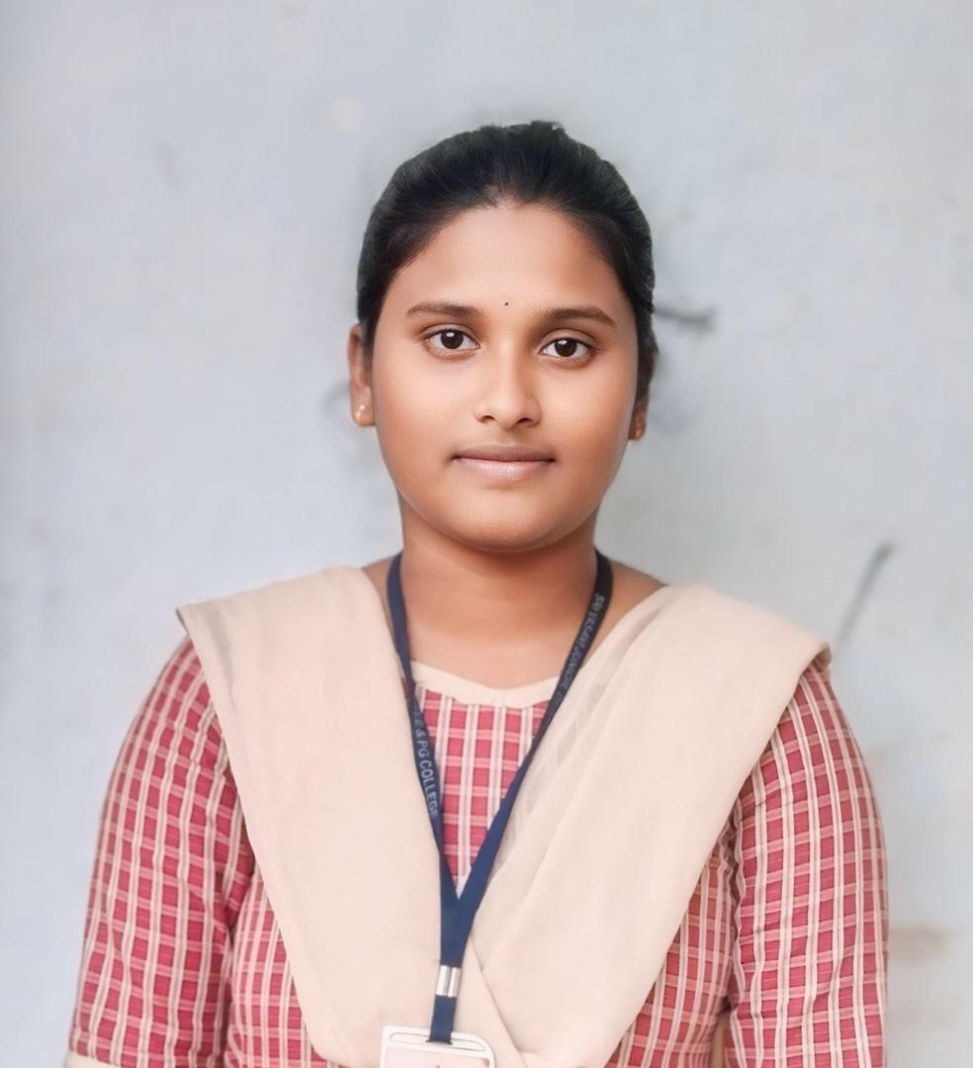
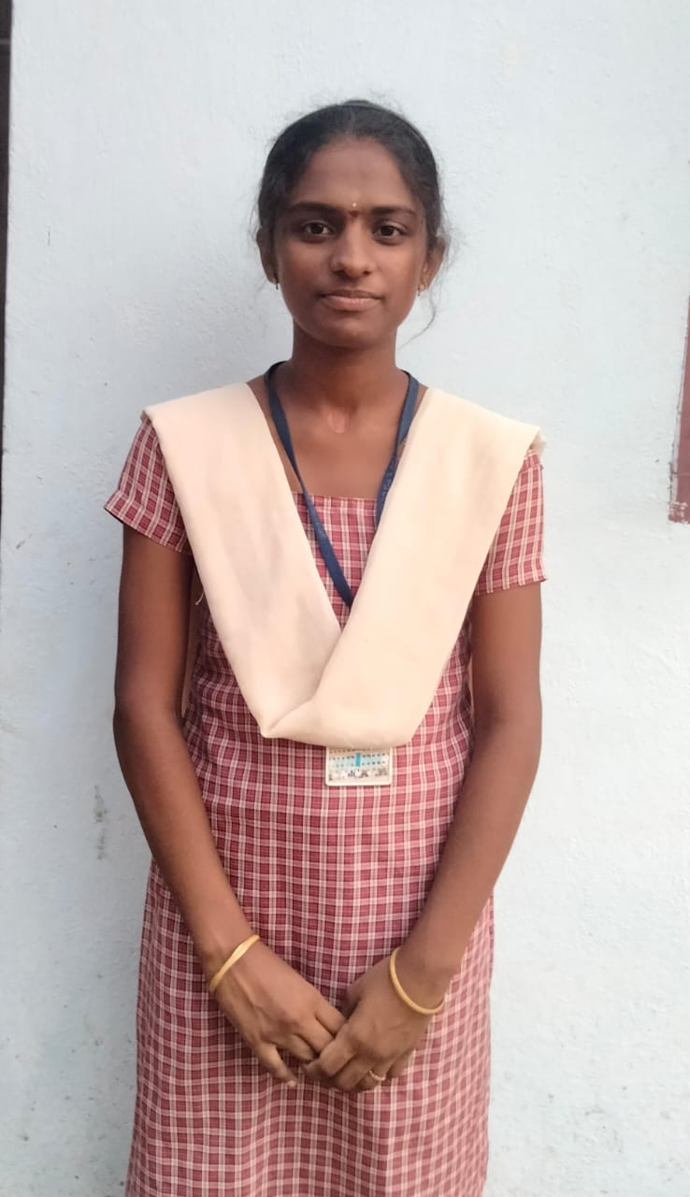
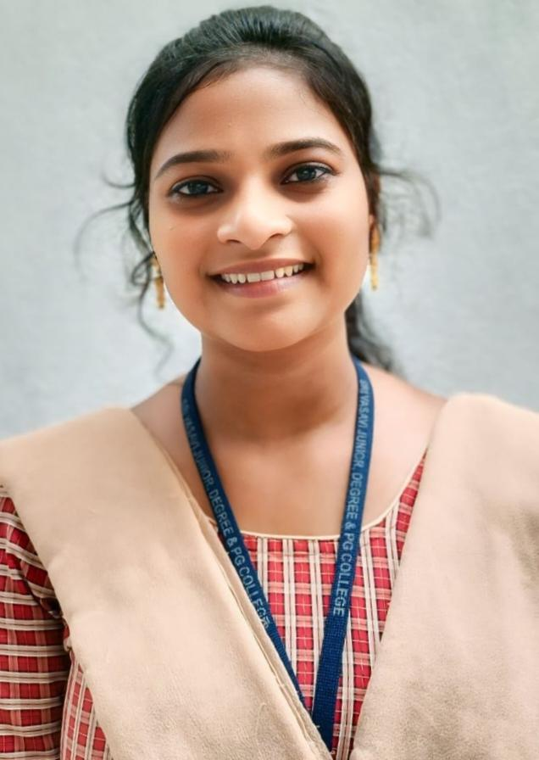
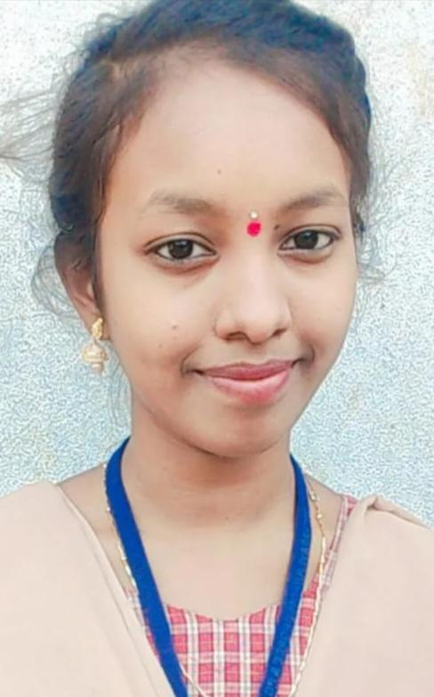
Team Leader
Name: Pasupuleti Jyothsna
Email:venkataramya244@gmail.com
Reg no:213888200065
Phn no: 9392811207
Team Member 1 Team Member 2 Team Member 3 Team Member 4
Name : Katakam Lakshmi Sravya Name :Patsa Jyothirmai Name :Peetala Vidya Prasanthi Name:Chalamcharla Padmavathi
Ma : sravskatakam501@gmail.com Email :sivanadiu516@gmail.com Email:princessvidya9581@gmail.com Email:padmavathichalamcharla9@gmail.com
Reg no: 213888200041 Reg no:213888200066 Reg no:213888200068 Reg no:213888200013
Phn no: 9014562967 Phn no:6300824498 Phn no:9581927307 Phn no:8125732705

Slide 4
CONTENTS:
1.Brand Study, Competitor Analysis & Buyer’s/Audience Persona:
Research Brand Identity
Competitor Analysis
Buyer’s/Audience’s Persona
2.SEO & Keyword Research:
SEO Audit
Keyword Research
On page Optimization

Slide 5
3.Content Ideas & Marketing Strategies:
Content Idea Generation & strategy
Marketing Strategies
Buyer’s/Audience’s persona.
4.Content Creation Curation:
Post Creation
Designs/Video Editing
Social Media Ad Campaigns
Email Ad Campaigns

Slide 6
Brand study , Competitor Analysis & Buyer's / Audience’s Persona
Brand study (Mission/Values & USP)
HDFC Bank, a leading financial institution, prides itself on a mission to provide innovative banking solutions that empower customers to achieve their financial goals. With a commitment to integrity, customer-centricity, and operational excellence, HDFC Bank aims to be the most preferred bank in India. Its unique selling proposition lies in its comprehensive range of products and services tailored to meet the diverse needs of individuals, businesses, and institutions. By leveraging cutting-edge technology and a robust network, HDFC Bank delivers seamless banking experiences, making it a trusted partner for millions of customers nationwide.

Slide 7
Analyze Brand Messaging HDFC Bank
HDFC Bank's brand messaging typically revolves around trust, reliability, and innovation. They emphasize their commitment to providing convenient banking solutions while prioritizing customer satisfaction and financial stability. Messages often highlight their wide range of products and services tailored to meet the diverse needs of customers, along with their digital initiatives to make banking more accessible and efficient. Overall, HDFC Bank aims to position itself as a trusted partner for individuals and businesses alike, offering solutions that empower customers to achieve their financial goals.

Slide 8
EXAMINE THE BRAND’S TAGLINE HDFC BANK
HDFC Bank's tagline "We Understand Your World" succinctly encapsulates their customer-centric approach and commitment to comprehensively meeting the needs of their clientele. This tagline communicates empathy and understanding, suggesting that HDFC Bank recognizes and empathizes with the diverse financial challenges and aspirations of their customers. It implies a deep understanding of the complexities of modern life and the various financial situations individuals and businesses encounter. By stating "your world," HDFC Bank positions itself as a partner that is intimately familiar with the lives and circumstances of its customers, and is dedicated to providing tailored solutions to address their financial needs effectively. Overall, the tagline reinforces the bank's focus on customer satisfaction and its dedication to offering personalized banking experiences.

Slide 9
Competitor Analysis
Competitor Analysis 1: State Bank of India
Competitor Analysis 2: ICICI Bank
Competitor Analysis 3: Axis Bank

Slide 10
COMPETITOR 1: STATE BANK OF INDIA
USP:
The Unique Selling Proposition (USP) of State Bank of India (SBI) lies in its position as the biggest nationalized bank in India, with a 23% market share by assets and a 25% share of the total loan and deposits market. SBI is also the largest domestic bank with international presence and strong government backing, offering a wide range of products and services through its extensive network of branches in India and overseas.
Online Communication:
T Access online communication for the State Bank of India, customers can use the State Bank Anywhere Personal mobile application, which offers various financial and non-financial transactions. The application is available on Google Play store, Apple App store, and Windows for Android, Apple, and Windows smartphones. Customers can transfer funds to accounts in SBI and other banks, manage debit cards, access and transaction limits, and more. The application is available to domestic Internet Banking customers and requires a one-time activation password sent to the registered mobile number. Customers can also use the m-Passbook feature to store and record transaction account activities.

Slide 11
SWOT Analysis of State Bank of India
Strengths:
Strong Brand Portfolio: State Bank of India has invested in building a strong brand portfolio, which is beneficial for expanding into new product categories.
High Customer Satisfaction: The company has a high level of customer satisfaction due to its dedicated customer relationship management department.
Weaknesses:
Limited Market Share Growth: Privatization of banking has led to a drop in market share for State Bank of India.
Bad Debts: The bank faces challenges in resolving bad debts, impacting its financial health.

Slide 12
SWOT Analysis of State Bank of India
SWOT
Opportunities:
Expansion into Rural Areas: State Bank of India has the opportunity to expand its reach into rural areas.
Technological Advances: With increased technological advancements, the bank can enhance its services and customer experience.
Threats:
Competition: Increased competition in the banking sector poses a threat to State Bank of India's market share.
Government Intervention: Government policies and interventions can impact the bank's operations.

Slide 13
Competitor 2. ICICI Bank
USP : ICICI Bank's unique selling proposition (USP) is its speedy disbursement of claims, which has been a key factor in its success in the insurance sector . This is particularly important in the health insurance segment, where ICICI Lombard has been rated the best in terms of customer satisfaction
Communication Line : Online communication for ICICI Bank involves updating your communication address through platforms like I Mobile Pay or the ICICI Bank Insta BIZ App. The process typically includes steps such as logging in, selecting the account number, indicating your relation to the address proof, entering grid values of the Debit Card, selecting the address proof document type, filling in address details, uploading the address proof document, accepting declarations, and updating passport details. If the address proof is in someone else's name, a relationship declaration form may need to be downloaded, filled, and uploaded.

Slide 14
SWOT Analysis of ICICI Bank
SWOT
Strength:
ICICI Bank is the second-largest bank in terms of total assets and market share, with a strong and transparent balance sheet.
It has a PAN India presence with numerous branches and ATMs, offering lifestyle benefits and exclusive tie-ups
Weakness:
Customer support and complaint resolution at ICICI Bank have faced challenges, with complaints about stringent debt recovery policies and high service
There have been reports of customer assault and abuse during debt recovery processes, impacting customer satisfaction.

Slide 15
SWOT Analysis of ICICI Bank
Opportunities:
With plans to open new branches and potential acquisitions of smaller banks, ICICI Bank can capitalize on its financial strength for growth.
The banking sector is expected to grow, presenting opportunities for ICICI Bank to expand its services and market share
Threats:
External threats include regulatory changes allowing foreign banks to invest more in Indian banking, competition from other major banks like HDFC, and the rise of micro-financing groups in rural areas
This SWOT analysis provides a comprehensive overview of ICICI Bank's current position in the market, its strengths to leverageweaknesses to address, opportunities to explore, and threats to mitigate.
.

Slide 16
Competitor 2. Axis Bank
USP: The Unique Selling Proposition (USP) of Axis Bank lies in its diverse range of banking products and services tailored to meet the specific needs of different customer segments. Axis Bank offers exclusive benefits like free NEFT transactions, a Priority Platinum Debit Card, Personal Accident Insurance cover, complimentary banking services, dedicated Relationship Managers, discounts on lockers, dining, movies, airport lounge access, reward points, and more with its Priority Salary Account.
Online Communication:
Axis Bank offers a variety of online communication channels for their customers to manage their banking needs. Their Internet Banking service provides features such as viewing account details, account balance, downloading statements, transferring funds, requesting cheque books, demand drafts, and stop cheque payments, and viewing portfolio details.
The Internet Banking service is accessible through various browsers and provides multiple layers of protection, including 128-bit encryption, secure login ID and password, and additional authentication in the form of Netsecure code for all transactions

Slide 17
SWOT ANALYSIS OF AXIS BANK
SWOT
Strength:
Market Leadership: Axis Bank holds a strong market leadership position in the Regional Banks industry, enabling it to rapidly scale new products and maintain high margins.
Brand Recognition: The bank enjoys strong brand recognition in the industry, allowing it to charge a premium compared to competitors.
Talent Management: Axis Bank focuses on talent management and skill development, essential for success in the banking sector.

Slide 18
Weakness:
Volatile Profits: Axis Bank has experienced highly volatile net profits over the years, indicating a need for stability in financial performance.
Absence of Strengths: Axis Bank e bank may lack certain strengths or resources required for sustained competitive advantage
Concentration in specific Areas: Axis Bank has gaps in corporate wholesale banking, treasury services, and retail banking, suggesting a need for diversification.
Foreign Branches: Only 8% of the bank's total assets are from foreign branches, indicating potential for further international expansion.

Slide 19
SWOT
Opportunities:
Expansion in Insurance Sector: Axis Bank can strengthen its foothold in the insurance sector by increasing its stake in Max Life.
Growth in Cards Market.: Integrating healthcare and wellness into the cards market can drive accelerated growth.
Threats:
Strong market presence: HDFC Bank is one of the largest private sector banks in India, with a wide network of branches and ATMs.
Robust financial performance: The bank consistently delivers strong financial results, with steady revenue growth and healthy profitability.

Slide 20
1.3 Buyer’s Audience Persona
Name: Priya Sharma
Age : 32
Occupation: Marketing Manager
Income : Rs.12 lakhs per annum
Location : Mumbai, Maharashtra, India
Background: Priya Sharma is a marketing manager at a mid-sized advertising agency in Mumbai. She is highly educated, holding a master's degree in marketing from a reputable university. Priya is tech-savvy and values convenience and efficiency in all aspects of her life, including banking.

Slide 21
Goals and Challenges:
Financial Stability:
Priya aims to manage her finances effectively to achieve long-term financial stability and security.Convenience: As a busy professional, Priya values banking solutions that are convenient and easily accessible, allowing her to manage her finances on the go.
Investment Opportunities:
Priya is interested in exploring investment opportunities to grow her wealth and achieve her financial goals.
Homeownership:
Priya dreams of owning her own home in Mumbai and is looking for mortgage options and financial assistance to make this dream a reality.
Retirement Planning:
Priya wants to start planning for her retirement and is seeking advice on retirement savings and investment options.

Slide 22
Preferences:
Digital Banking: Priya prefers banking solutions that offer seamless online and mobile banking experiences, allowing her to manage her accounts, pay bills, and transfer funds conveniently from her smartphone or laptop.
personalized Service:Pe While Priya values the convenience of digital banking, she also appreciates personalized assistance and advice from banking professionals when needed.
Transparent and Competitive Rates: Priya is looking for banking products and services with transparent fees and competitive interest rates that offer value for money.
Innovative Solutions: Priya is interested in innovative banking solutions and technologies that simplify banking processes and enhance her overall banking experience.
Trust and Reliability: Trustworthiness and reliability are essential factors for Priya when choosing a bank, and she prefers banks with a strong reputation for customer service and financial stability, such as HDFC Bank.By understanding Priya Sharma's goals, challenges, preferences, and demographics etc.

Slide 23
2. SEO & Keyword Research
2.1 SEO AUDIT
Performing a comprehensive SEO audit for HDFC Bank would involve analyzing various aspects such as website structure, on-page optimization, backlink profile, content quality, mobile optimization, and technical SEO factors. Due to the complexity and depth.
Website Structure and Navigation : Assess the organization and hierarchy of the website's pages . Check for clear and user-friendly navigation menus .Ensure proper internal linking for easy navigation and SEO benefits..
On-Page Optimization : Evaluate the optimization of key landing pages for relevant keywords . Check title tags, meta descriptions, and headings for optimization . Ensure proper keyword usage in content while maintaining natural readability.

Slide 24
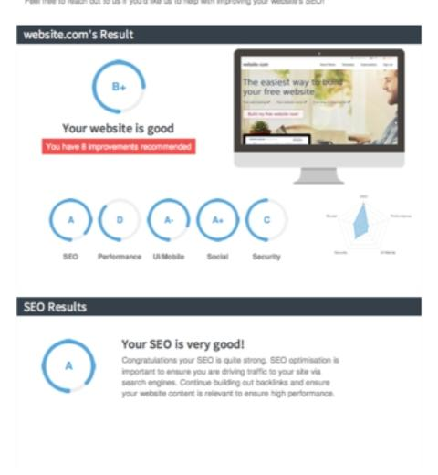
SEO Audit
An SEO audit for HDFC Bank would involve assessing the bank's website to ensure it's optimized for search engines like Google. This includes reviewing factors such as website structure, keyword optimization, content quality, backlink profile, mobile-friendliness, and user experience. The goal is to identify opportunities to improve the bank's online visibility and rankings in search engine results pages (SERPs).

Slide 25
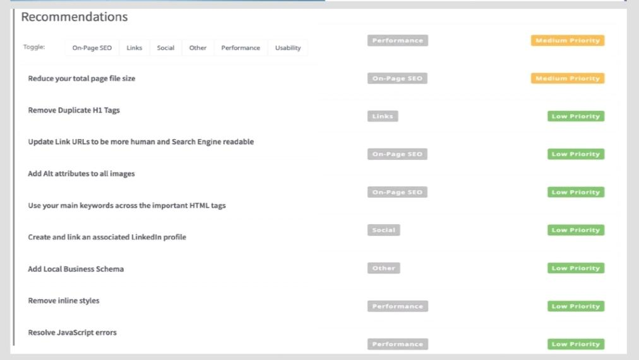
SEO Audit

Slide 26
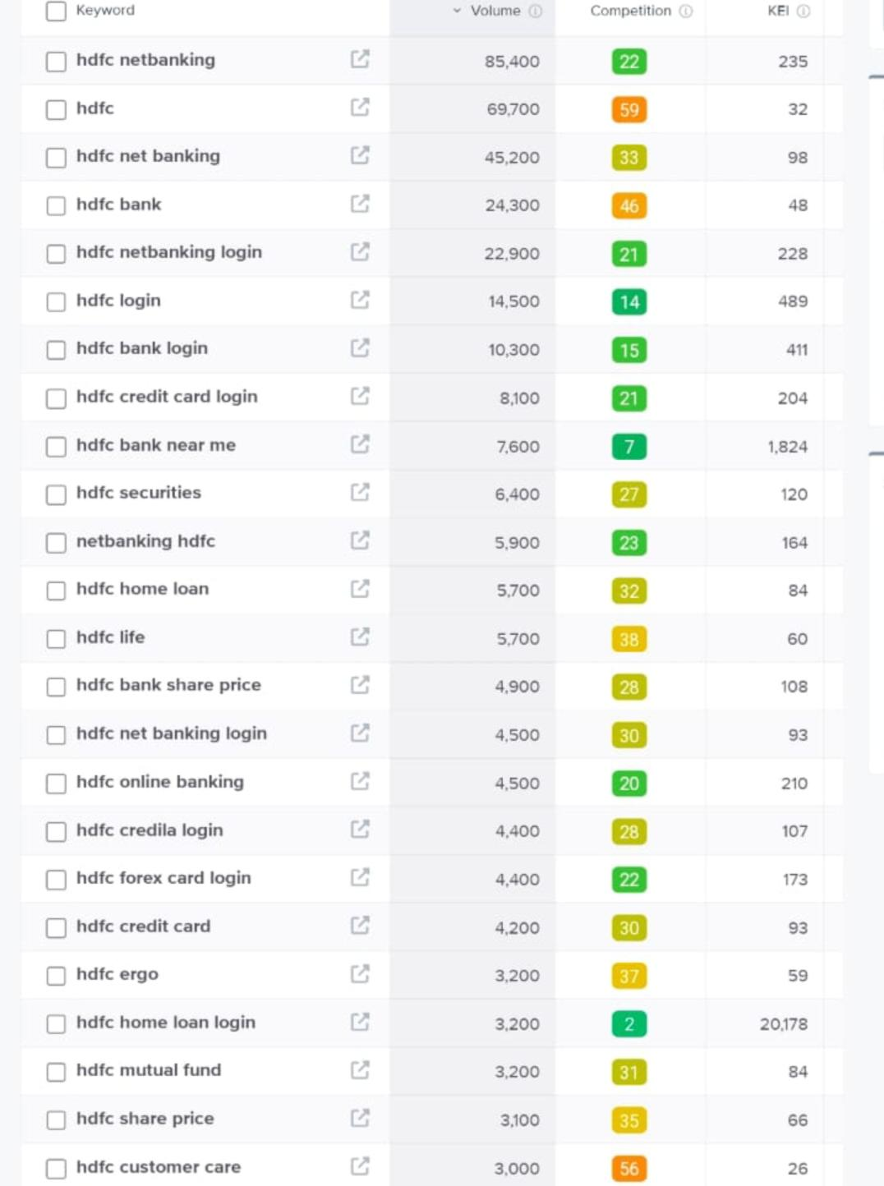
Keyword Research
Keyword research for HDFC Bank would involve identifying relevant keywords that potential customers might use when searching for services offered by HDFC Bank
1. Types of accounts: "HDFC Bank savings account types", "HDFC Bank current account options", "HDFC Bank fixed deposit account features"
2. Credit cards offered: "HDFC Bank credit card types", "HDFC Bank credit card rewards", "HDFC Bank credit card eligibility"
3. Mobile banking app features: "HDFC Bank mobile app download", "HDFC Bank app transaction limits", "HDFC Bank app security measures"
4. Online banking services: "HDFC Bank net banking features", "HDFC Bank online account opening", "HDFC Bank mobile banking registration"

Slide 27
On Page Optimization
Focus Keyword : HDFC Net Banking, HDFC login, HDFC bank credit card
Meta Title : HDFC login, HDFC bank credit card
Meta Description: HDFC Bank regalia credit card: This card offers exclusive benefits like complimentary airport lounge access, rewards on spending, travel privileges, and insurance coverage.

Slide 28
On page optimization (content optimization)
Introduction:
HDFC Bank is committed to empowering its customers with valuable financial knowledge and resources. Through a diverse range of content initiatives, the bank aims to foster financial literacy, support customer success stories, and provide insights into digital banking services.
Financial Education Series: Create articles, videos, and infographics explaining financial concepts like budgeting, saving, investing, and credit management.Customer Success Stories: Share stories of how HDFC Bank has helped customers achieve their financial goals or overcome challenges.
Product Spotlights: Highlight different banking products and services offered by HDFC Bank, explaining their features and benefits.
Industry Insights: Write articles or produce videos discussing trends and developments in the banking and finance industry.

Slide 29
Document the challenges faced during the research and analysis phrases as well as the key insights gained from the keyword research process
We understand how the users search & gained insights into the kind of keywords People search for.
Getting a free tool to do keyword research is a task since most tools are paid
Relevant choosing the right keywords an issue since there were a lot of relevant Keywords in the list.

Slide 30
Part 3: Content Idea and Marketing Strategies
3.1 Content Idea Generation & strategies
Content ideas generation and strategies refer to the process of brainstorming, planning, and executing the creation of valuable and engaging content for a target audience. It involves identifying topics, formats, and distribution channels that resonate with the audience's interests and preferences.
Content ideas generation involves techniques such as researching trending topics, conducting keyword research, analyzing competitor content, and understanding audience demographics and psychographics. Strategies for content creation include developing pillar content (comprehensive pieces covering broad topics), diversifying content formats (e.g., articles, videos, infographics), repurposing content across different channels, and engaging with the audience through interaction and feedback.
Overall, content ideas generation and strategies aim to attract, engage, and retain the audience's attention while ultimately achieving the desired marketing goals, such as brand awareness, lead generation, or customer retention.

Slide 31
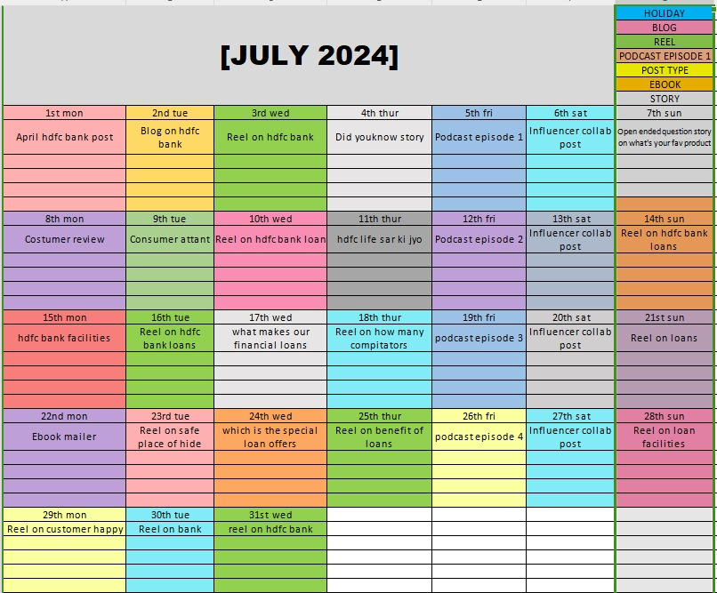

Slide 32
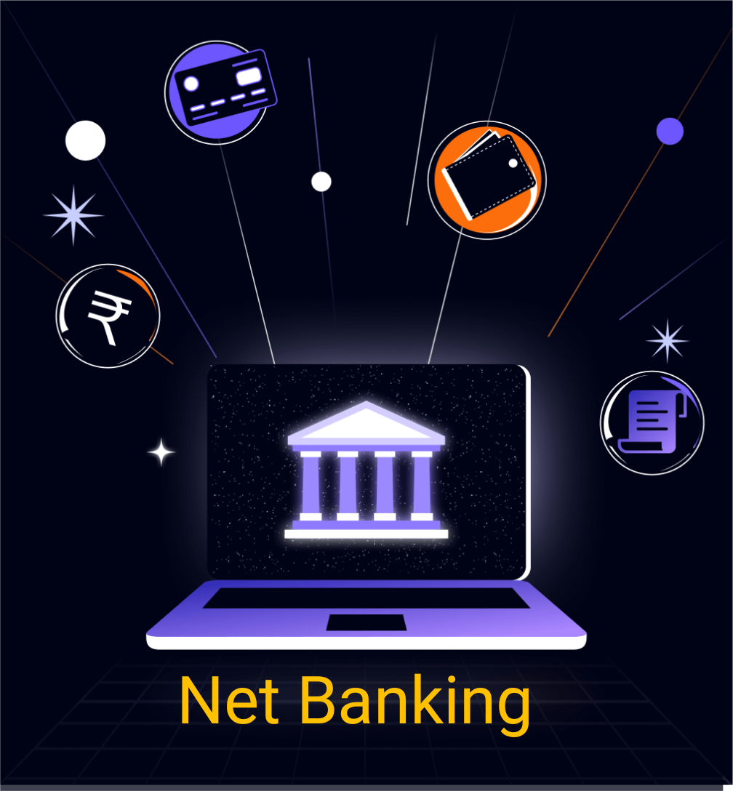
Strategy Aim and the idea behind this story
The strategy behind HDFC Bank's success story is primarily centered around customer-centricity, innovation, and prudent risk management. They focus on providing convenient banking services, leveraging technology to enhance efficiency, and maintaining a strong risk management framework to ensure stability and sustainability Additionally, their emphasis on employee training and development contributes to their consistent performance and growth.

Slide 33

Statergy , Aim and the idea behind the post
The aim of HDFC Bank's posts on social media could vary, but generally, they likely aim to engage customers, promote their products and services, share financial advice, highlight corporate social responsibility efforts, or showcase their commitment to innovation and technology in banking. The underlying idea is to connect with their audience, build brand loyalty, and stay top-of-mind in the competitive banking sector.

Slide 34
Part 3: Marketing Strategies
HDFC Bank can implement a comprehensive marketing strategy to bolster its brand presence and attract more customers. By leveraging a mix of traditional and digital channels, HDFC Bank can engage its target audience effectively. Through content marketing initiatives, such as informative blog posts and videos, the bank can educate customers about its various products and services.
Content Marketing: Produce informative content about financial planning, investments, and banking services to engage and educate customers.
Social Media Marketing: Utilize platforms like LinkedIn, Twitter, and Facebook to share updates, promotions, and interact with customers.
Influencer Marketing: Collaborate with financial influencers or industry experts to endorse HDFC Bank's products and services.

Slide 35
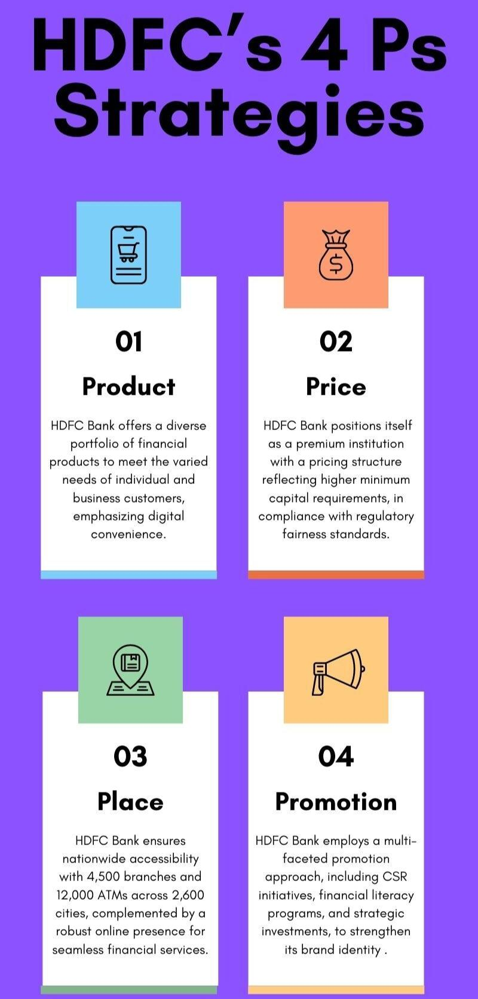
Digital Marketing: Utilize digital channels such
as social media, email marketing, search engine
optimization (SEO), and online advertising to reach
and engage with target audiences. Create informative
and engaging content that educates customers about
HDFC Bank's products and services while showcasing
its commitment to innovation and convenience.
Personalized Marketing: Implement data-driven marketing
strategies to personalize communications and offers based
on customer preferences.

Slide 36
Part 4: Content Creation and Curation
4.1 post creation
HDFC Bank, one of India's leading private sector banks, continues to innovate and expand its services to meet the evolving needs of its customers. With a strong focus on technology.
Format 1: Static Post on Net Banking
Format 2: Reel Post on HDFC Bank Login
Format 3: Carousel Post on Credit Card

Slide 37
Part 4.Content Creation and Curation
Format 1: Static Post on Net Banking
Caption:"Empowering Your Financial Journey:
Experience Seamless Banking with HDFC Bank"
Hashtags:
#HDFCBank #BankingInnovation
#DigitalBanking
#CustomerServiceExcellence
#ConvenienceBanking
#TrustedPartner

Slide 38
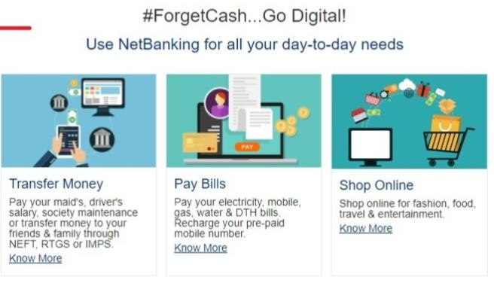
Format 2: Reel Post on HDFC Bank Login
Caption:"Banking on Trust: Your Financial
Companion, HDFC Bank."
Hashtags:
#HDFCBank #BankingSolutions
#FinancialEmpowerment
#InnovationInBanking
#TrustedPartner
https://www.instagram.com/reel/C6BU4Kcpywv/?igsh=dThndjdpeDE2aWxl

Slide 39
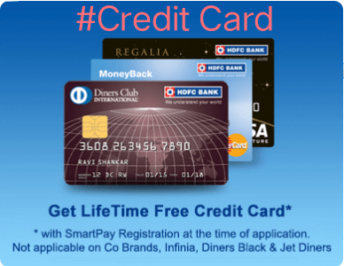
Format 3: Carousel post on Credit Card
Caption:"Unlock endless possibilities with the HDFC Bank Credit Card – your key to convenience, rewards, and financial freedom."
Hashtags:
#HDFCCreditCard
#CreditCardRewards
#FinancialFreedom
#Convenience

Slide 40
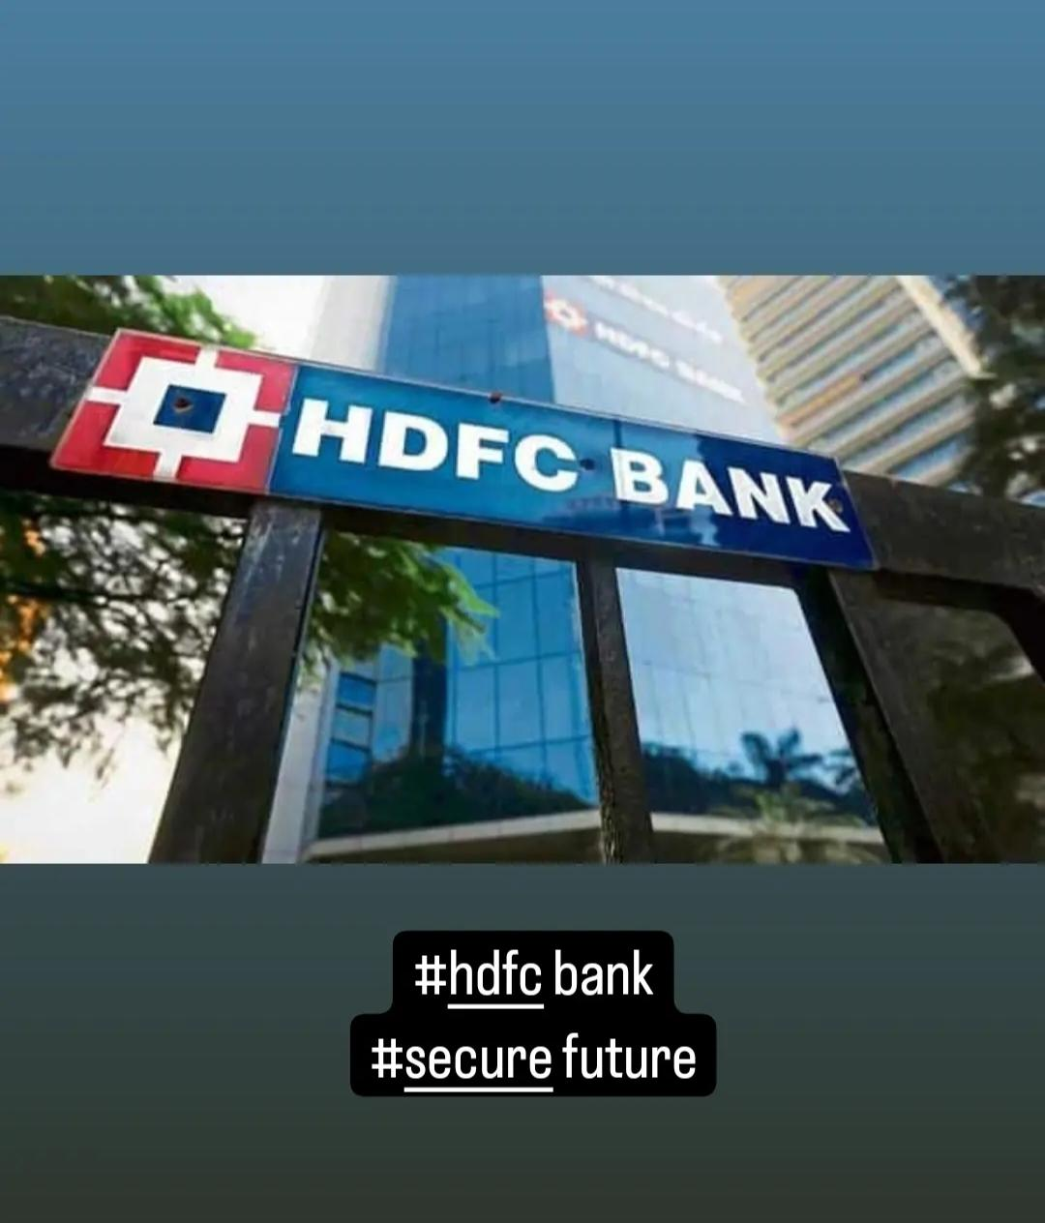
Part 4 : Content Creation and Curation
Instagram Story:
Utilize the stories feature on instagram for two consecutive days . Share behind the scenes glimpse etc. to encourage participation.
Screenshot of Story: https://www.instagram.com/stories/hdfcbank9391/3350421388311125962?utm_source=ig_story_item_share&igsh=MmVkbzU5eXJibWJj

Slide 41
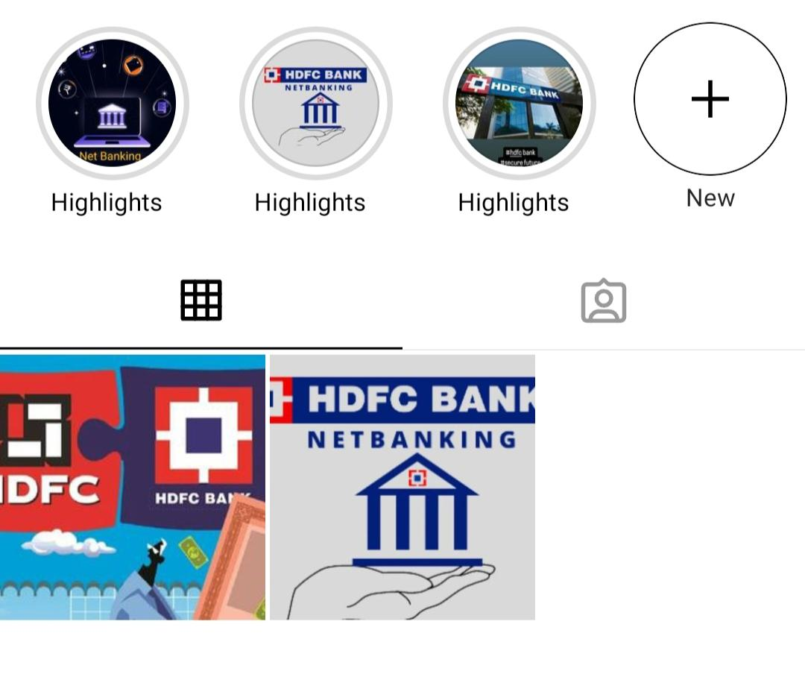
Highlights of the story
https://www.instagram.com/s/aGlnaGxpZ2h0OjE4MDQ1ODI3OTY1NjcyODcz?story_media_id=3350421388311125962_66297651435&igsh=NDUzcDhlMGF5ODc5

Slide 42
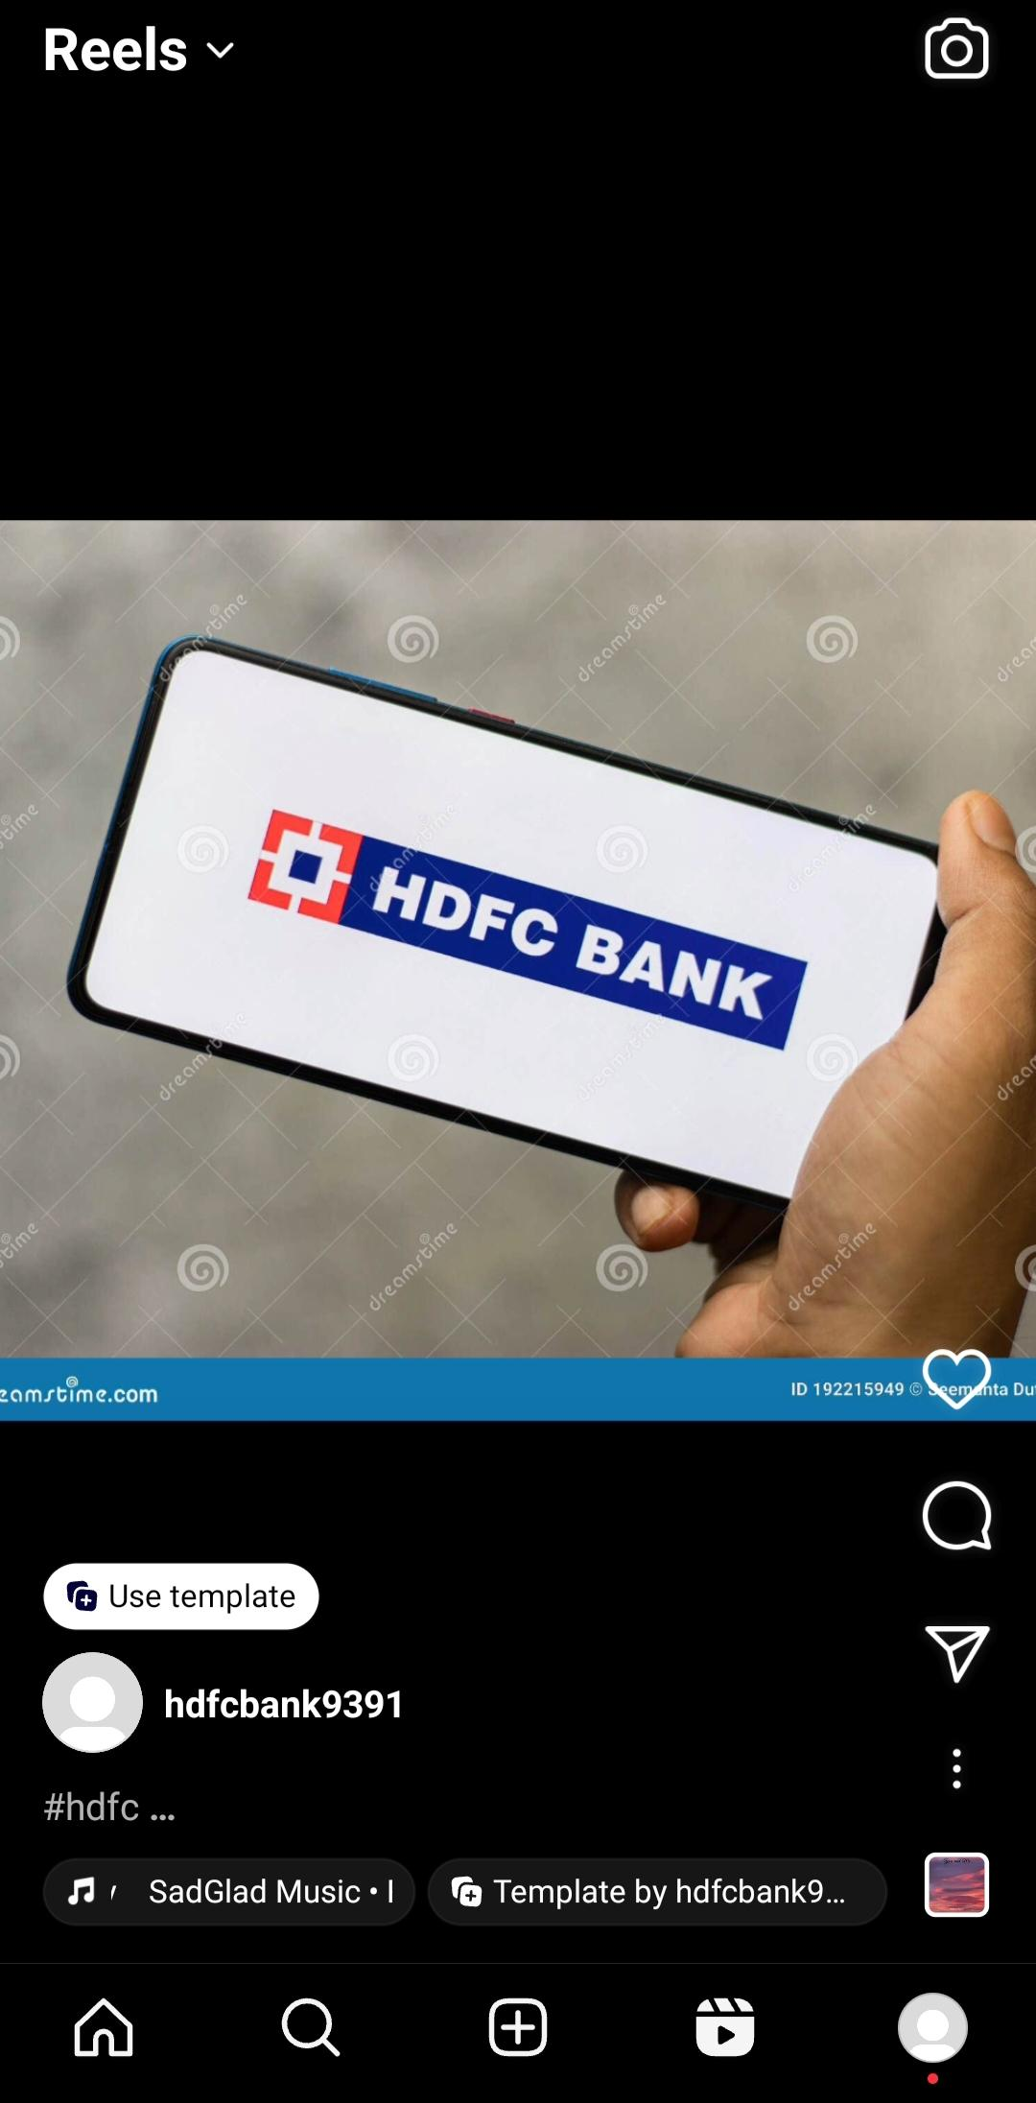
Instagram Reel
https://www.instagram.com/reel/C6BU4Kcpywv/?igsh=dThndjdpeDE2aWxl

Slide 43
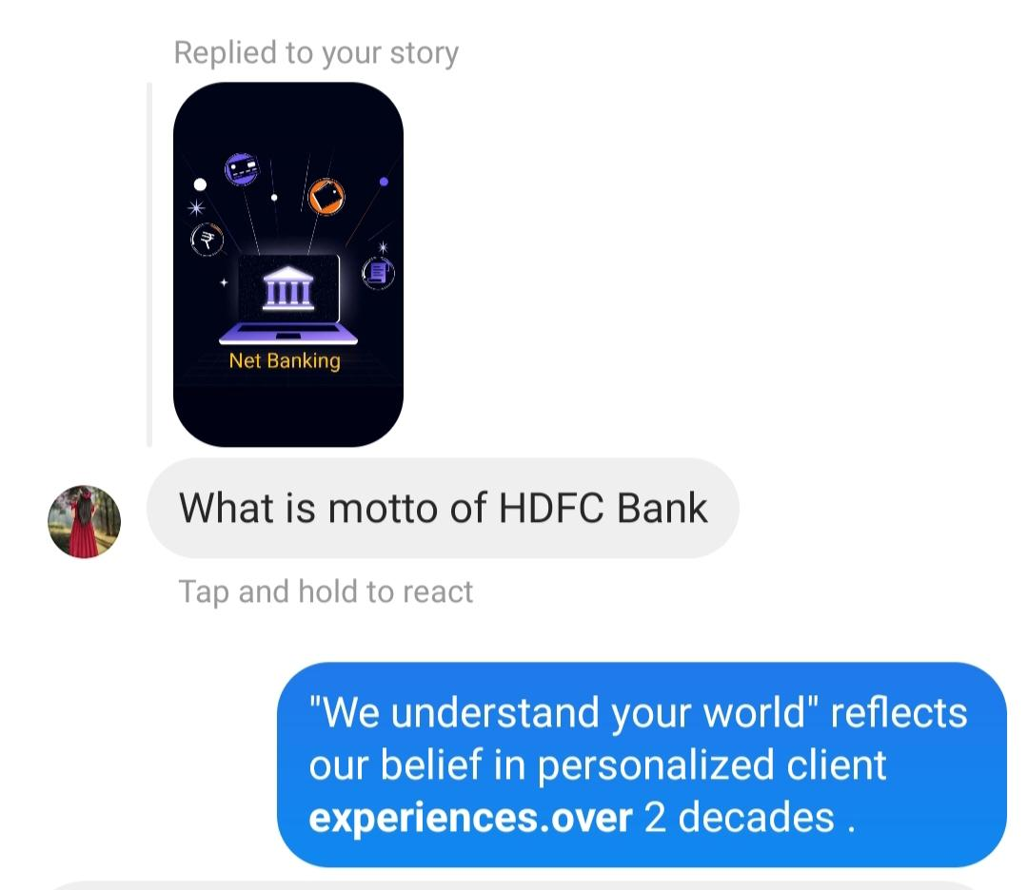
Story Insights Q&A
Reach is__20
Likes is ____18
Etc…….
Areas for improvement:
1)Story could be better, quiz option would
Help in getting engagement.
2)Since the shares of information stories are more
We could create more and informative the
stories.
Story Insights-Q&A

Slide 44
4.2 Designing/Video Editing
Designing: Designing involves creating visual concepts using various tools and techniques to communicate messages or solve problems. It encompasses a wide range of disciplines such as graphic design, web design, user interface (UI) design, and more. Designers use elements like colors, typography, images, and layout to create visually appealing and functional designs for print, digital media, products, and environments
Video Editing: Video editing software like Adobe Premiere Pro, Final Cut Pro, or DaVinci Resolve is commonly used to perform these tasks.In summary, designing focuses on creating visual concepts acroideo editing is the process of manipulating and rearranging video footage to create a cohesive and compelling narrative.
Video editors trim, cut, and arrange clips, add transitions, special effects, and audio to enhance the story or message conveyed in the video. ss various mediums, while video editing specifically involves manipulating video footage to tell a story or convey a message effectively.

Slide 45
4.3 Social Media Ad Campaigns
HDFC Bank's social media ad campaigns are designed to resonate with diverse audiences, catering to their financial needs and aspirations. From #DreamBigWithHDFC, spotlighting inspiring success stories, to #BankingMadeEasy, emphasizing convenient digital banking solutions, each campaign embodies HDFC Bank's commitment to customer satisfaction and innovation.
Dream Big With HDFC: Highlight success stories of customers who achieved their dreams with HDFC Bank's financial products and services, encouraging others to pursue their aspirations.
Financial Fitness Challenge: Create a campaign promoting financial literacy and responsibility, offering tips, quizzes, and challenges to help followers improve their financial health with HDFC Bank's support.
HDFC ForEver Need: Showcase the wide range of banking solutions offered by HDFC Bank, from savings accounts and loans to investment options and insurance, emphasizing how the bank caters to diverse needs.

Slide 46
4. Community First: Showcase HDFC Bank's corporate social responsibility initiatives and community outreach programs, highlighting the bank's efforts to make a positive impact on society.
5. Banking Beyond Borders: Highlight HDFC Bank's international banking services and benefits for customers who frequently travel or have global financial needs, emphasizing convenience and accessibility worldwide.
6. Banking Made Easy: Highlight the convenience and accessibility of HDFC Bank's digital banking platforms, encouraging users to experience hassle-free banking on their smartphones or computers.
These campaigns can be executed across various social media platforms like Facebook, Instagram, Twitter, LinkedIn, and YouTube, using a mix of engaging content formats such as videos, infographics, testimonials, and interactive posts.

Slide 47
Email Ad Campaigns
Email ad campaigns for HDFC Bank could involve various promotions, offers, or services provided by the bank. These campaigns might include informing customers about new banking products, credit card offers, loan options, investment opportunities, or simply providing updates on the bank's services. The content and design of these emails would aim to attract recipients' attention and encourage them to engage with the bank's offerings.
HDFC Bank's email ad campaigns are strategic initiatives designed to inform and engage customers with the bank's diverse range of products and services. These campaigns aim to communicate promotional offers, new product launches, and updates on banking features in a compelling and personalized manner. Through targeted messaging and visually appealing content, HDFC Bank endeavors to enhance customer satisfaction, drive product adoption, and strengthen its relationship with customers.

Slide 48
THANK YOU

